Slide 1
Pranav Ladkat
http://pranavladkat.github.io/
www.linkedin.com/in/pranavladkat
www.github.com/pranavladkat

Slide 2
Presentation Overview
About me
Prior Work Experience
Projects from graduate studies
Conclusion

Slide 3
About me
Master of Science in Mechanical Engineering, 3.74/4
University at Buffalo, The State University of New York, August 2013 – June 2015
Emphasis on Scientific Computing
Bachelor of Engineering in Mechanical Engineering
University of Pune, June 2007 – May 2011

Slide 4
About me
Member of Technical Staff, Skytree (Aug 2015 – Dec 2015)
Part of HPC/ML Team
Writing and maintaining parallel algorithms that are both multi-threaded and multi-machine
Refactor code to take advantage of memory access patterns, utilize SIMD architecture
Profiling code to find bottlenecks and suggest/implement solutions
CFD Engineer and Mesh Developer, ANSYS Inc., India (Nov 2011 – July 2013)
Worked on implementing and improving mesh generation features such as Shell meshing, Splitting boundary layers
Provide support for ANSYS tools to various customers in Automotive industry
Worked on various Aerodynamics and Heat Transfer related projects

Slide 5
Master’s Project, University at Buffalo
Title: “3D Unsteady Vortex Panel Method and its applications in Aerodynamics”
Solves for inviscid flow over body
Calculates aerodynamic forces such as pressure, lift, drag, moments, etc.
Motivation: To get solution quickly (in seconds) and provide input to various control systems
E.g. Wind turbines, power generating kites
Developed C++ code from scratch
Solution part of the code is parallelized using OpenMP
Graduate Advisor: Iman Borazjani

Slide 6
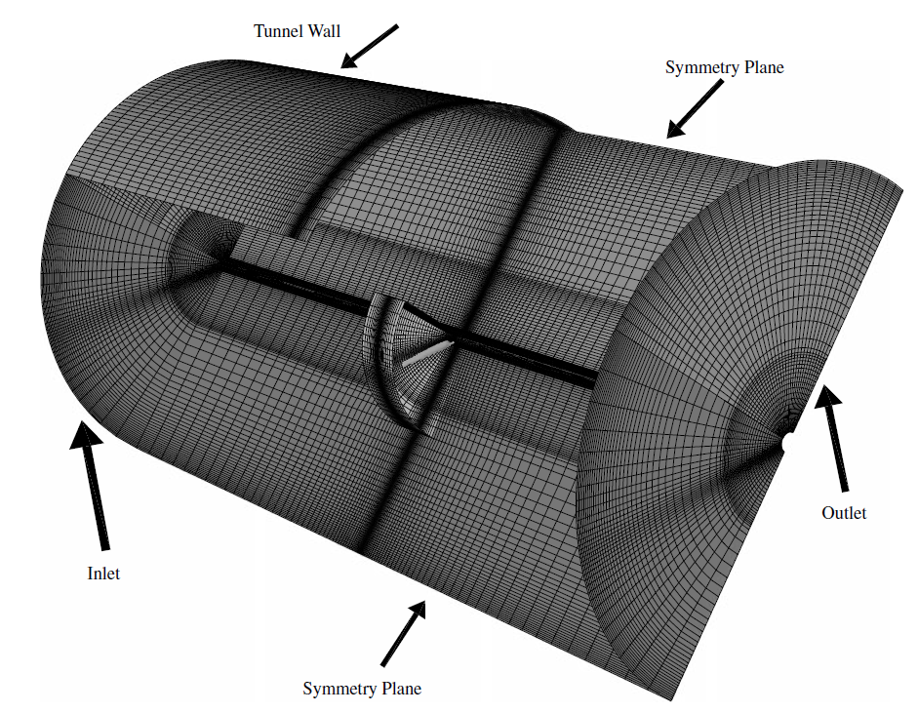
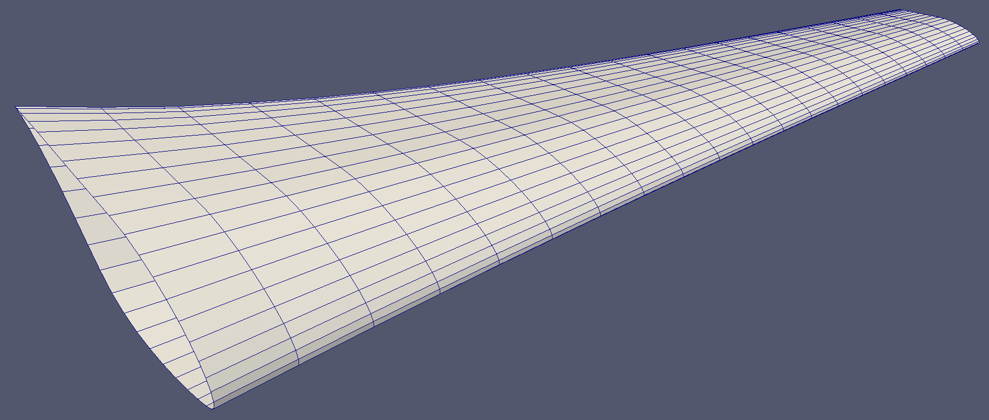
Master’s Project
Panel Method vs traditional CFD methods
Panel Method:
No volume mesh, hence small mesh size
Mesh size used: ~800 elements
Ref. “Navier–Stokes Predictions of the
NREL Phase VI Rotor in the NASA Ames 80 ft x 120 ft Wind Tunnel”-Wind Energ. 5:151–169
CFD Mesh
Mesh for Panel method

Slide 7
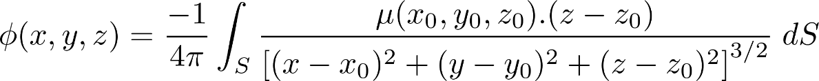
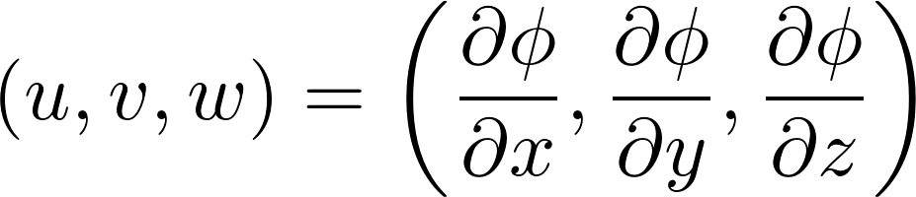
Master’s Project
Not going into mathematics, but as an overview:
Each element has 2 coefficients: Source and Doublet
Correct combination of these elements gives flow over body
Source element
Doublet element
Potential due to Source element
Potential due to Doublet element

Slide 8
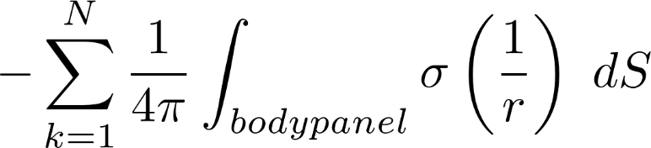
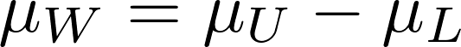
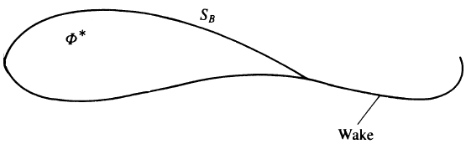
Master’s Project
Equation to solve (Boundary Conditions):

Slide 9
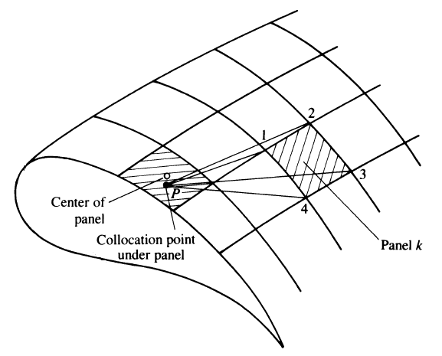
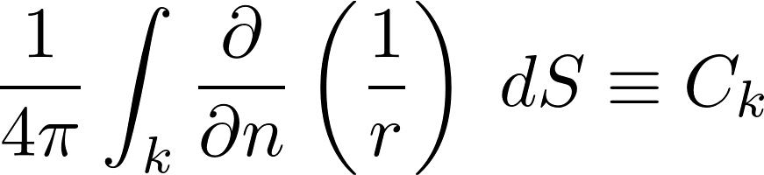
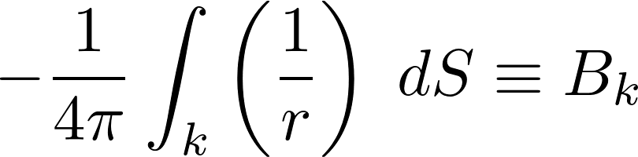
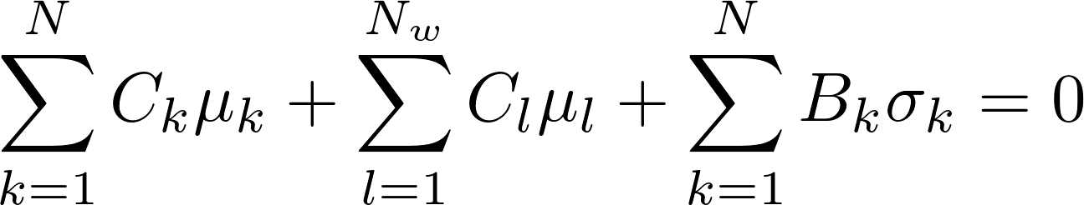
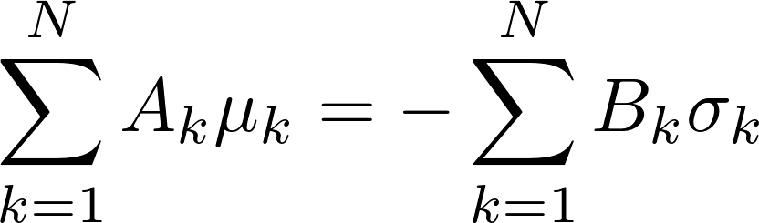
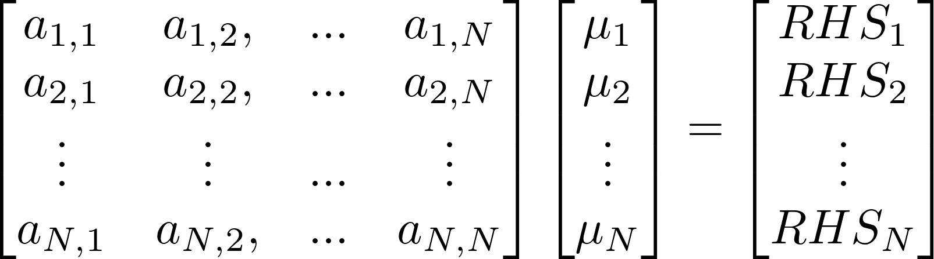
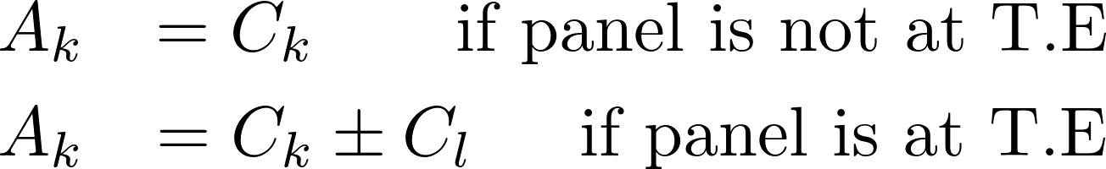
Master’s Project
Reducing problem to a set of algebraic equations

Slide 10
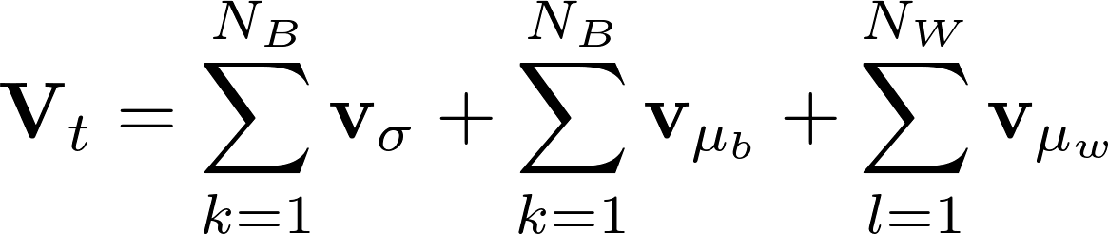
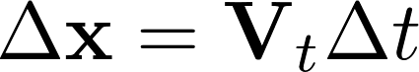
Master’s Project
Force Free Wake model is used in the current work
Wake is deformable surface
Wake panels are convected with local velocity
1Δt
2Δt
3Δt
11Δt

Slide 11
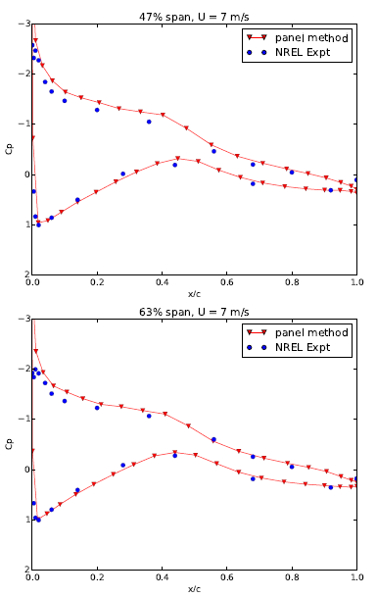
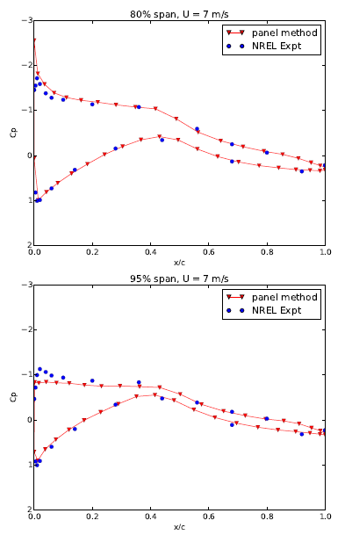
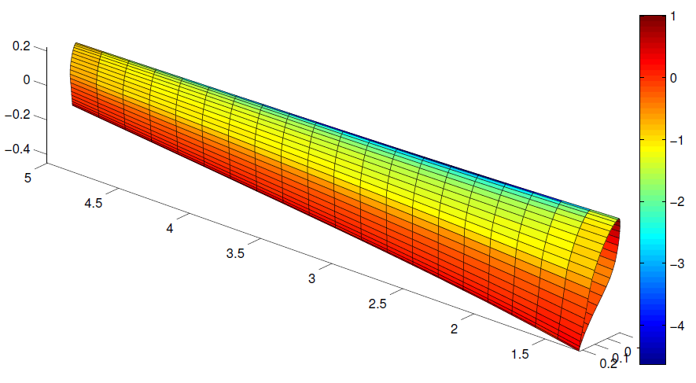
Master’s Project
Comparison of developed code with experimental data from “NREL – Unsteady Aerodynamics Experiment Phase-VI”
U∞ = 7 m/s
ω = 71.63 RPM
Coefficient of Pressure

Slide 12
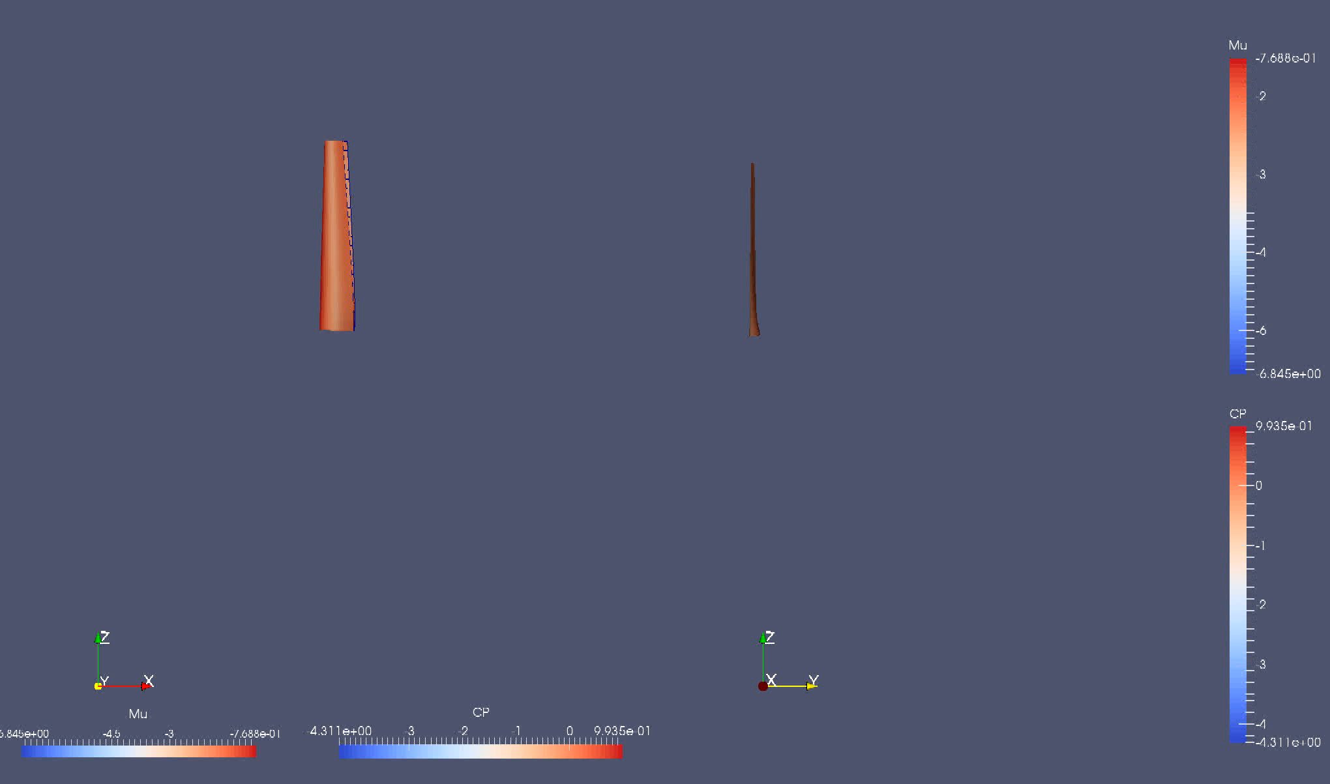
Master’s Project
Solution: Wind Turbine Blade

Slide 13
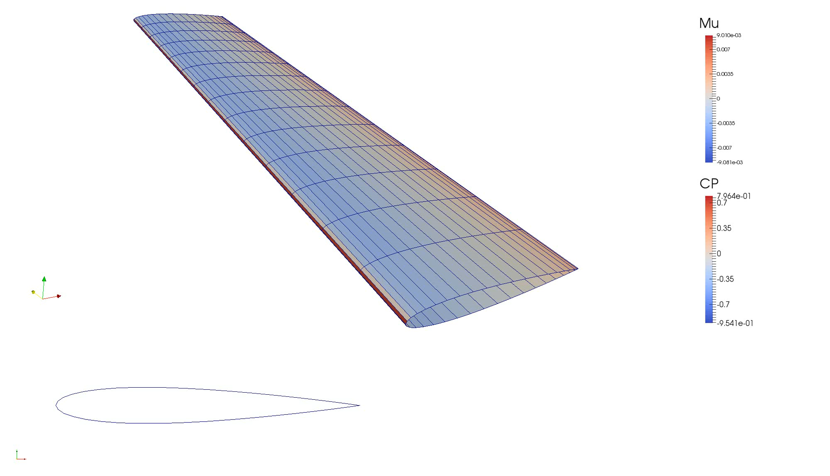
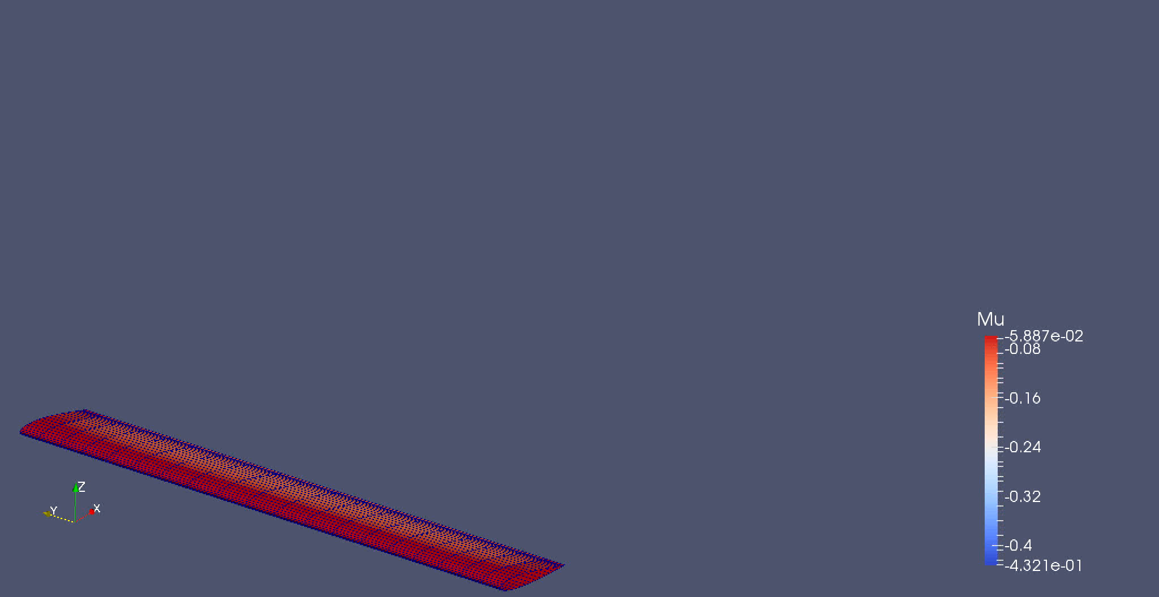
Master’s Project
Output Video:
NACA0012 placed in uniform flow NACA0012 heaving motion

Slide 14
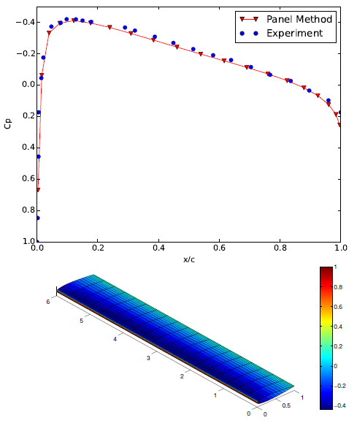
Master’s Project
NACA0012 at 0 AOA
Classes defined:
Mesh reader (plot3d)
Surface and wake containers
Solver
Output writer (VTK)
Parameters
Domain
Vector3d
Detailed class diagram:
http://pranavladkat.github.io/files/3dvpm_uml/index.html

Slide 15
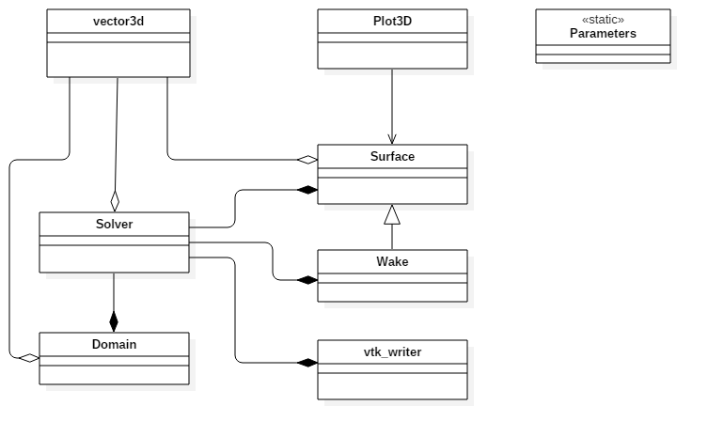
Master’s Project
Code Design
Implemented as a Library
The main() set up and run simulation

Slide 16
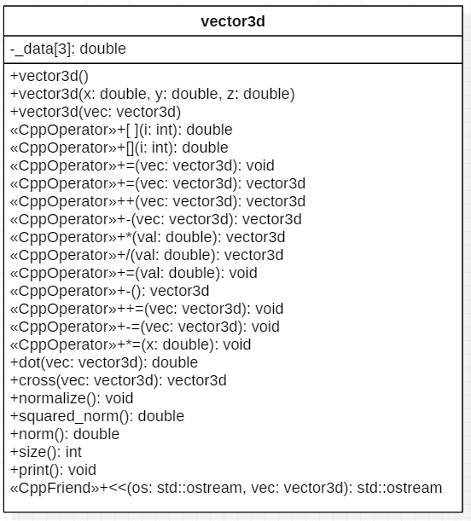
Master’s Project
Class: vector3d
wrapper to an array of length 3
Stores coordinates and various vectors
Provide ease to write vector equations
Much clean code

Slide 17
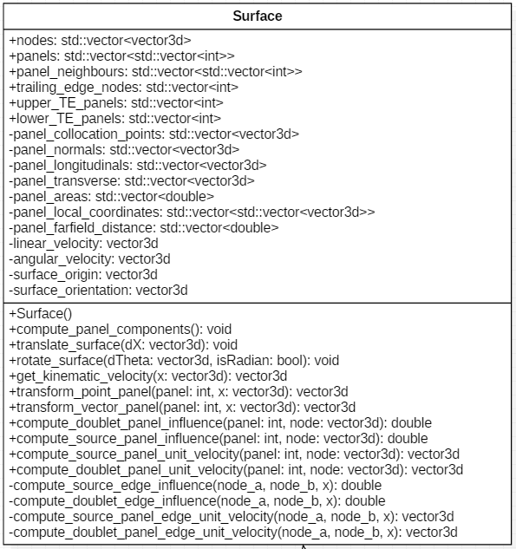
Master’s Project
Class: Surface
Represents a surface body
Stores all geometry information
Performs all calculations related to geometry
Perform geometry movements

Slide 18
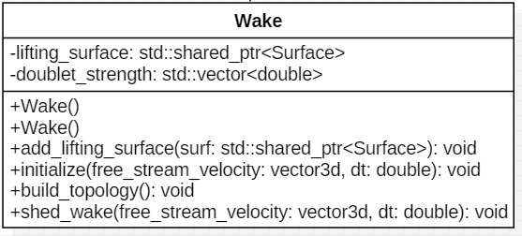
Master’s Project
Class: Wake (Derived from Surface)
Wake is a deformable surface
Solver class manipulates Wake surface as part of solution

Slide 19
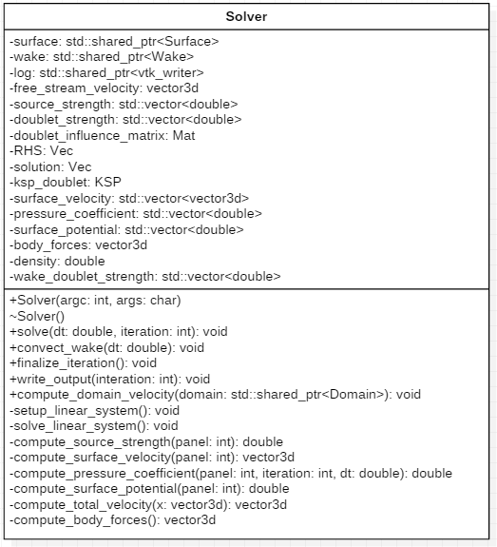
Master’s Project
Class: Solver
Solver::Solve() is the driver function
Solver sets up system of equations and solves it
Post-process results to get aerodynamic forces
Write solution to an output file in correct format

Slide 20
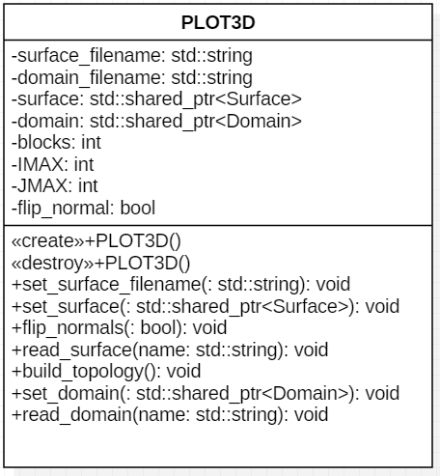
Master’s Project
Class: Plot3d
Reads mesh file and fills basic surface details
Also reads domain object

Slide 21
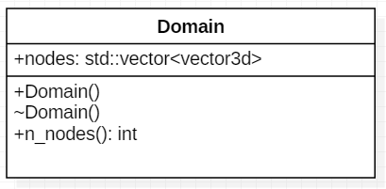
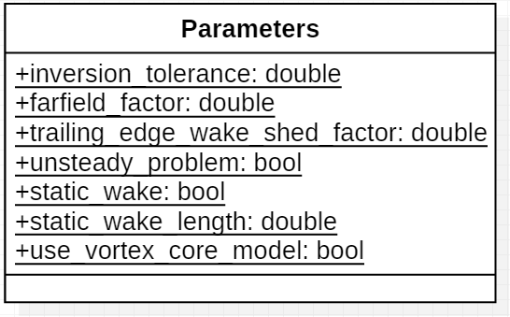
Master’s Project
Class: Domain
Domain contains points where we post-process results
Optional class
Class: Parameters
Includes public static variables which sets up program behavior
They are mostly set to defaults

Slide 22
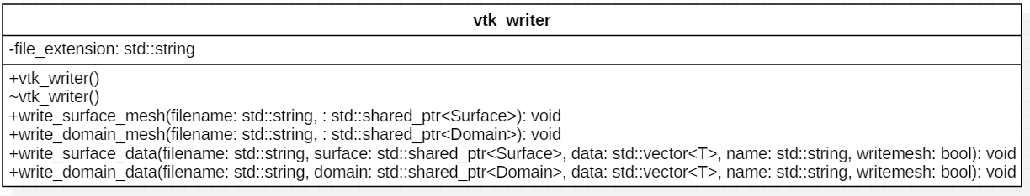
Master’s Project
Class: vtk_writer (Output file format)
Summary:
Validated results of the developed code with various experimental data and analytical solutions
The solution takes less than 1 sec to compute per time step for mesh size ~800 elements
Predicts aerodynamic forces for 3D and fully Unsteady problems

Slide 23
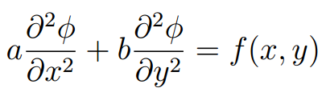
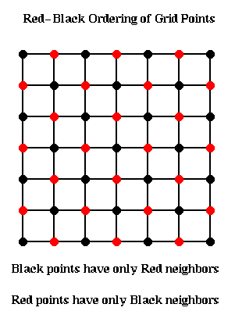
HPC Course Project
Parallel Successive Over Relaxation Solver using OpenMP, MPI and CUDA
Solves generic Poisson Equation using Red-Black SOR
Compares parallel speedup for OpenMP, MPI and CUDA implementations
Classes defined:
Poisson Equation
Boundary Conditions
Grid
Solver
SOR equation:
Source: Internet
Red/Black ordering

Slide 24
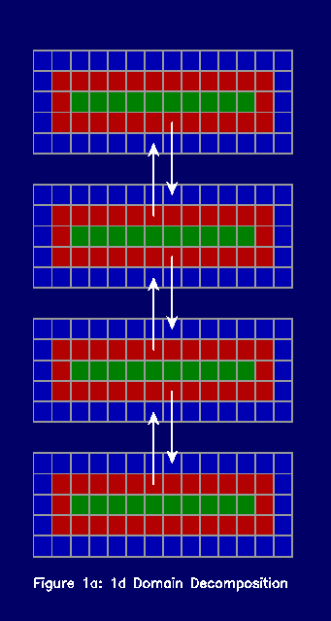
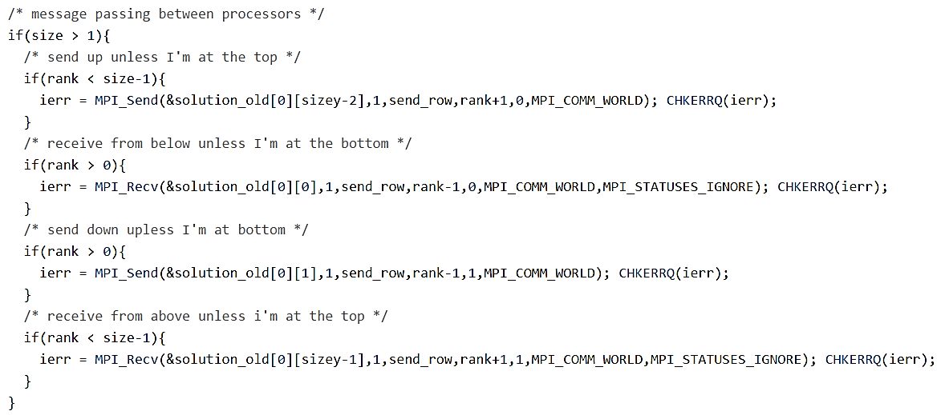
HPC Course Project
MPI details
Domain Decomposition
Message passing in MPI
Source: Internet

Slide 25
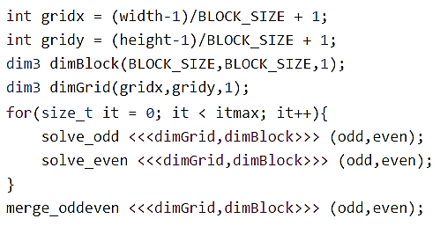
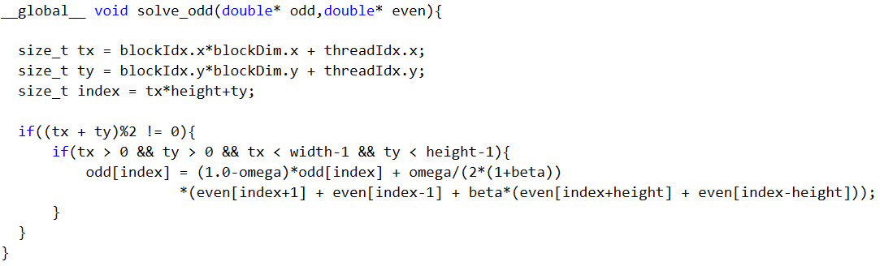
HPC Course Project
CUDA
No global synchronization, hence need to split kernel function

Slide 26
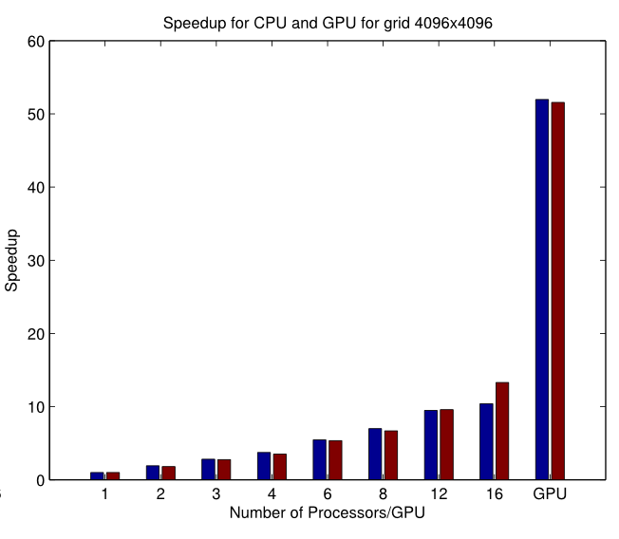
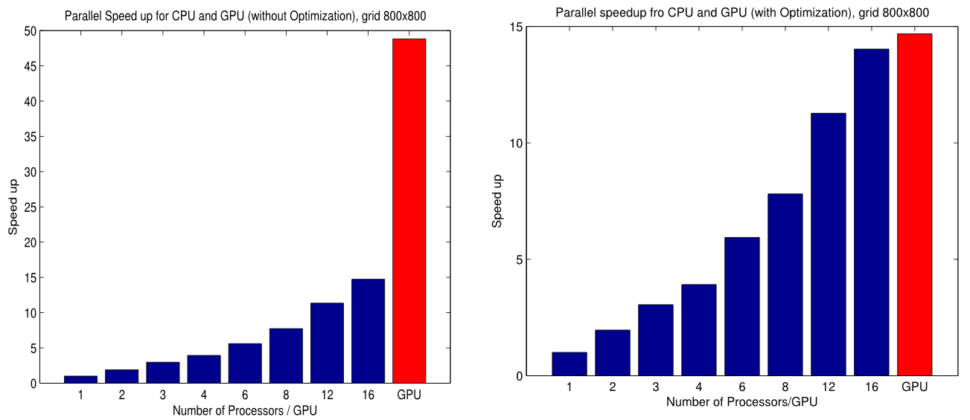
HPC Course Project
OpenMP achieved parallel efficiency of 93% for 12 CPU cores
MPI achieved parallel efficiency of 89% for 12 CPU cores
CUDA code achieved a speedup of ~5 compared to 16 cores

Slide 27
Conclusion
Overall great learning experience
Enhanced programming skills significantly
Gained HPC and parallel programming skills
Work experience provided good industrial outlook, and customer driven product development
I’m still learning and will continue to learn…

Slide 28
Thank you!

